Slide 1
CS 215
Project
Autumn 2014

Slide 2



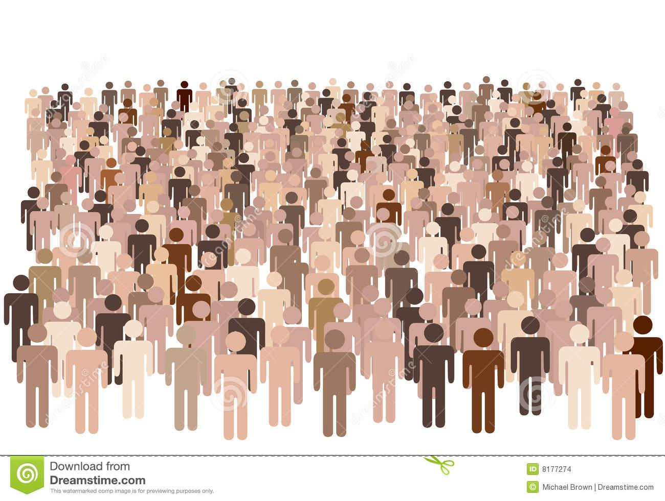
Motivation
GDP
India
Goods Exports
Internet Users %
Population

Slide 3
Motivation
Repositories of facts containing this information can be found at many places, like data.worldbank.org, Wikipedia infoboxes etc.
Countries are popular and finite, finding complete knowledge bases is possible
What about less popular entities?
“What is the population of Arbit Apartments, Powai?”
“What is the GDP of Sugarcane Industry of India?”
“% of Internet users in Samalkha?”
What about less popular facts about popular entities?

Slide 4
Motivation
Good news!
Web is huge, probably, there is some page which contains the information we are looking for.
The way in which you express a fact about an entity depends on the fact, and not the entity.
We may expect the sentence structure to be similar.
Sentence structure can be captured by POS tag sequences, words, paths in dependency parse tree and so on
Population of India is 1.3 billion, making it the second largest country in the world | Population of Arbit Apartments, Powai reached 1300

Slide 5
Problem Statement : Introduction
Given that we know a lot about countries, can we train extractors that run over the web and pull similar facts about other entities?
Maybe, but we'll need some training data first
Hand labeling : Pick sentences having numbers and countries, and label with the relation expressed
1 million newswire articles have 1.5 million sentences having a country and a number!
Will take 4166 hours with 10 seconds per sentence, need to automate the process

Slide 6
Problem Statement : Given
A Knowledge Base (KB) of the form:
/m/0jhd 3313739780 NY.GDP.MKTP.CD
/m/0jhd 3052467460 NY.GDP.MKTP.CD
/m/0jhd 3176749570 NY.GDP.MKTP.CD
/m/07z5n 4.7466025 IT.NET.USER.P2
/m/07z5n 5.082334 IT.NET.USER.P2
/m/07z5n 5.850585 IT.NET.USER.P2
/m/0j1z8 83600 AG.LND.TOTL.K2
/m/0j1z8 83600 AG.LND.TOTL.K2
/m/0j1z8 83600 AG.LND.TOTL.K2
/m/0jgd 2736690 AG.LND.TOTL.K2
/m/0jgd 2736690 AG.LND.TOTL.K2
/m/0jgd 2736690 AG.LND.TOTL.K2
All numbers will be standardized to SI units

Slide 7
Problem Statement : Given
Entity-Id map
/m/035qy Greece
/m/06tnn South Georgia and the South Sandwich Islands
/m/0345_ Guatemala
/m/034tl Guam
/m/036b_ Guinea-Bissau
/m/034m8 Guyana
/m/03h2c Honduras
/m/03gyl Haiti
/m/03ryn Indonesia
/m/03spz Israel
/m/03t1s Isle of Man
/m/0168b British Indian Ocean Territory
/m/0d05q4 Iraq
/m/03_xj Jersey
/m/03_r3 Jamaica

Slide 8
Problem Statement : Given
A set of sentences and number – country pairs in the sentence.
Sentence id [TAB] sentence [TAB] numbers [TAB] entities
1 Palau is among the world's smallest countries, with some 20,000 people scattered across 190 square miles (490 square kilometers) of lush tropical landscapes (Palau;190,20000,490)
2 After about half of the ballots were counted, 93.1 percent of them were against the bill, which was designed to compensate British and Dutch banking customers for their losses when bank Icesave, an Icelandic Internet bank, collapsed in the fall of 2008, said Iceland's public broadcaster RUV. (Britain, Netherlands, Iceland;2008,93.1)
3 We have a three million tourist population that comes in compared to Malaysia’s 22 million (and) Thailand’s 14 million, he said. (Thailand,Malaysia;14000000,22000000)
Unit canonicalization and Country identification

Slide 9
Problem Statement : Desideratum
Find out:
1. Relations expressed in a sentence and
2. The corresponding confidence score
SentId [TAB] Country [TAB] Relation [TAB] Number [TAB] Score
For the sentences shown in the previous slides:
3 Malaysia SP.POP.TOTL 14000000 SCORE_1
3 Malaysia SP.POP.TOTL 22000000 SCORE_2
2 NULL NULL NULL NULL
Multiple Relations per sentence are possible
Multiple Relations for a given country and number pair are also possible, with different confidence scores

Slide 10
Challenges and Food for Thought
Basic software setup: reading files, forming maps from country to id
Ways to assign confidence scores
Can matchings from multiple sentences be used to calculate the confidence score?
For a given country and relation, we have several values, each pertaining to different years. Can this fact be used while matching?

